Slide 1

Vehicle Comparison
Alfred Francis

Slide 2
Introduction
We are checking on the following hypotheses:
Are Electric car more economically beneficial to the consumer?
Testing the spend/saving a over five-year stretch between Electronic Vehicles and Hybrid Vehicle.
Testing the spend/saving over a five-year stretch between Electric Vehicles and Diesel Vehicles.
Which vehicles are more cost efficient?

Slide 3
T - Test
The first hypothesis:
This t-test will be on the comparison between Electric car and Hybrid car.
It will test the spend/savings on these vehicles for a five-year stretch.

Slide 4
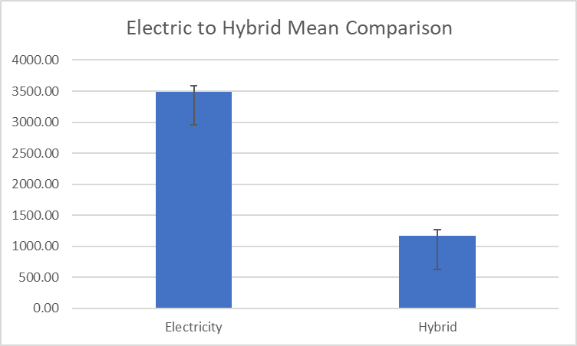
T-Test Indication
What is indicated from the t-test.
This chart indicates the there’s a significant difference between Electric Vehicles and Hybrid Vehicles.

Slide 5
T-Test Conclusion
What is shown in the chart.
With the chart showing a significant difference between the Electric Vehicles and the Hybrid Vehicles, there’s a 95% confidence interval.

Slide 6
First T-Test Conclusion
From the results of the t-test
The p value is greater than 5%.
This indicates that there is a significant difference between the Electric Vehicle and the Hybrid Vehicle.

Slide 7
SecondT-Test
The second hypothesis:
This t-test will be on the comparison between Electric car and Diesel Engine vehicles.
It will test the spend/savings on these vehicles for a five-year stretch.

Slide 8
Second T-Test Indication
What is indicated from the t-test.
This chart indicates the there’s a significant difference between Electric Vehicles and Diesel Vehicles.

Slide 9
Second T-Test Conclusion
What is shown in the chart.
With the chart showing a significant difference between the Electric Vehicles and the Hybrid Vehicles, there’s a 95% confidence interval.

Slide 10
Second T-Test Conclusion
From the results of the t-test
The p value is greater than 5%.
This indicates that there is a significant difference between the Electric Vehicle and the Diesel Vehicle.

Slide 11
Conclusion for both hypotheses
In both t-test the p value is greater than 5%.
There is a significant statistical difference.
We have a Confidence Interval of 95%.
I recommend the Hybrid and Diesel Vehicles over the Electric Vehicles.

Slide 12
Thank You
Any Questions?

